Slide 1

Pediatric Oncological Operating & Recovery Room Upgrade Global Grant # GG2685872
Partners:
Rotary Club of Thousand Oaks
Rotary Club of Tijuana
Centro Oncologico Pediatrico/Fundacion Castro Limon
& Hopefully You!
rotarytijuana.org/club/

Slide 2
Why Partner with Us?
Founded October 31st 1931
Installed 1st stoplight in Tijuana
26 year English Laboratory with RC La Jolla & Thousand Oaks
Over $3M in Children’s health projects – Castro Limon & Hospital de las Californias
+$7M of firefighter equipment coordinated and donated to the district Fire Houses
16 Past District Governors
Rotaract & Interact Parnters

Slide 3

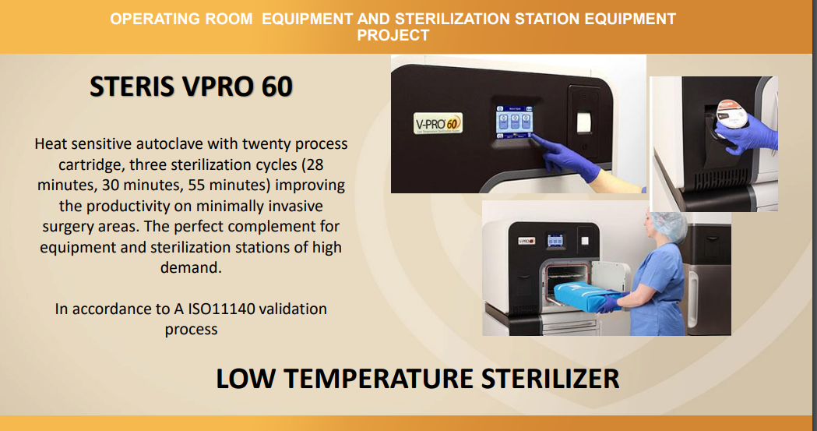

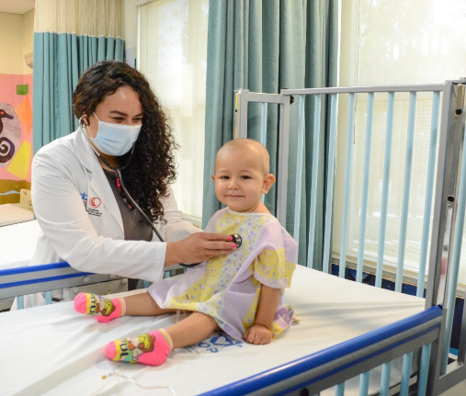
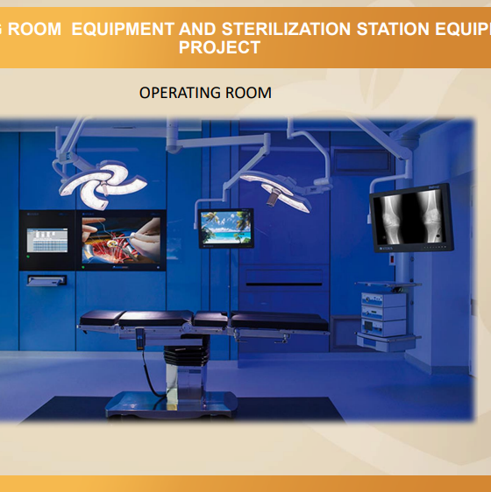
The cause
Cancer In Mexico is the leading cause of death in Children between 5 & 14 years of age
Surgeries are essential in cancer care!
300 surgeries and procedures Annually
Appropriate equipment will allow Castro Limon to serve 90% more children.

Slide 4
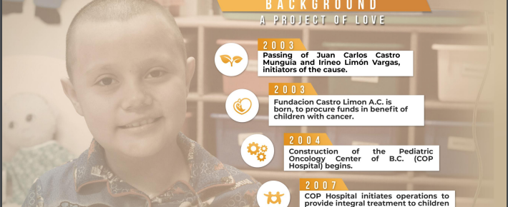


The history of Castro Limon Foundation – Our Partner organization
285,102 Health Services offered between 2003 to today
Integral care of more than 297 families
116 Children & adolescents declared “Cancer Free”
76 Patients being treated currently

Slide 5

Castro Limon | Sterilization & Operating Center
Project Description: This project supports the upgrade/update of the sterilization equipment, recouperation & operating rooms to be in compliance with new Mexican FDA (COFEPRIS) requirements to insure continued treatment of children with Cancer In-house. This decreases total cost of programs from requesting use of external sterilization & improves the attention to the children after surgery.
Project Cost: $196K
Global Grant # GG2685872
Time line: 12 months
Area of interest: Disease prevention & treatment
Sustainability: Castro Limon foundation has fundraising to support sustained maintenance and service of the operating room & equipment

Slide 6
Funding Status

Slide 7
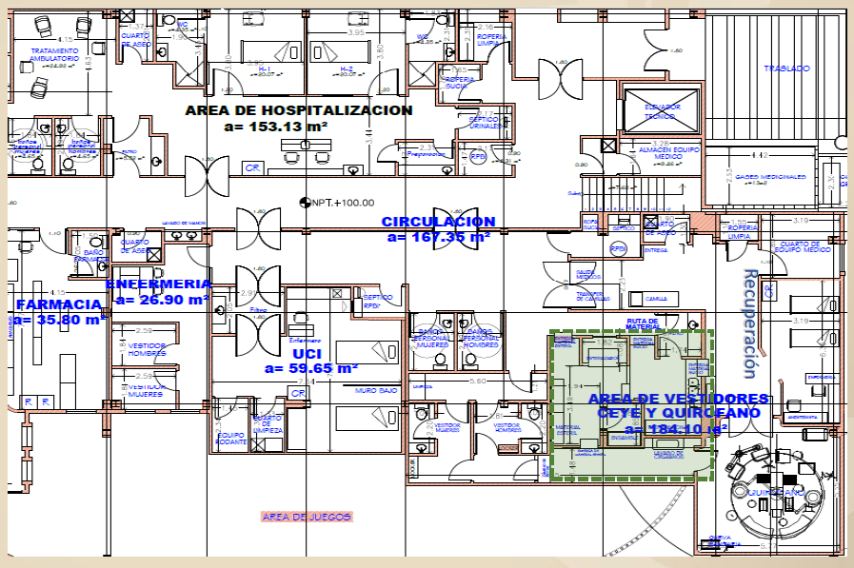
Castro Limon | Sterilization & Operating Center | Layout of Installation:

Slide 8

Thank you
Global Grant # GG2685872
Partners:
Rotary Club of Thousand Oaks
Rotary Club of Tijuana
Centro Oncologico Pediatrico/Fundacion Castro Limon
& Hopefully You!
Heather Johnson – Heatho74@hotmail.com
https://rotarytijuana.org/club/

